Slide 1
Impact of Malicious TCP Retransmission on Cellular Traffic Accounting
Younghwan Go, Denis Foo Kune*, Shinae Woo,
KyoungSoo Park, and Yongdae Kim
KAIST University of Michigan*
Notes:
Good morning. My name is Younghwan Go, I’m going to talk about whether we should account for TCP retransmissions in the cellular traffic or not.
This is a joint work with Denis, Shinae, KyoungSoo and Yongdae.

Slide 2




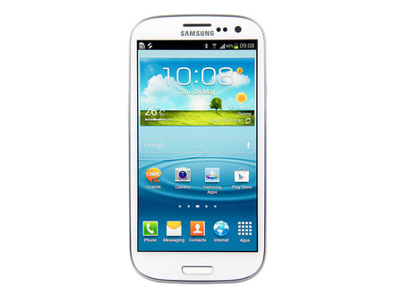








Mobile Devices as Post-PCs
Smartphones & tablet PCs for daily network communications
Notes:
We use mobile devices such as smartphones and tablet PCs for most of daily network communications now.
We use smartphones to watch videos, listen to music, play games, do facebook, send emails, and so on.

Slide 3
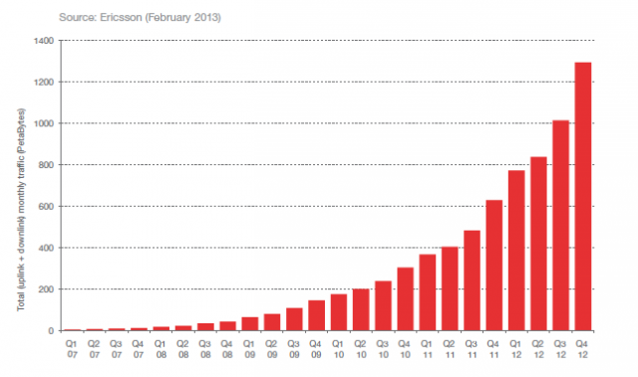
Mobile Devices as Post-PCs
Smartphones & table PCs for daily network communications
Massive growth in cellular data traffic
2x increase
in one year!
Notes:
As a result, we are seeing a massive growth in cellular data traffic in very short time.
Ericsson reported that just during last year, the usage of cellular data traffic has doubled in volume.
What is the side effect of this explosive growth?

Slide 4
Cellular Traffic Accounting
Increase in cellular traffic bill
Average: $71 per month (2011) – J.D. Power & Associates
AT&T | 1GB | 4GB | 6GB | 10GB | 15GB | 20GB
Mobile Share with Unlimited Talk & Text | $40 | $70 | $90 | $120 | $160 | $200
Verizon | 1GB | 2GB | 4GB | 6GB | 8GB | 10GB
Mobile Share with Unlimited Talk & Text | $50 | $60 | $70 | $80 | $90 | $100
Cellular network subscribers want accurate accounting!
Notes:
As people use more and more traffic, obviously they have to pay more. As of 2011, the average cellular bill was $71 per month.
As we can see with AT&T and Verizon, as people ask for more data, the price increases.
So it is inevitable that all cellular network subscribers want accurate accounting of their data usage.

Slide 5
3G/4G Accounting System Architecture
Charging Data Record (CDR)
Billing information (e.g., user identity, session elements, etc.)
Record traffic volume in IP packet-level
Question:
Should we account for TCP retransmissions?
$
NodeB
BS
3G UMTS
RNC
S-CDR
G-CDR
SGSN
GGSN
NodeB
CGF
UE
Internet
Target Server
eNodeB
S-GW
P-GW
4G LTE
MME
RAN
CN
Notes:
Here’s the architecture of the cellular ISP.
When the client UE communicates with the target server, the packets flow through the ISP core network’s SGSN & GGSN.
The information for billing, CDR, is stored in the two GSNs during communication, then is transferred to the billing system where the actual accounting takes place.
And the basic unit for accounting is byte-per-byte IP packets.
Alright. So we now know that all IP packets flowing through the ISP are accounted.
Then here’s an interesting question. Should we then account for all retransmitted packets?

Slide 6
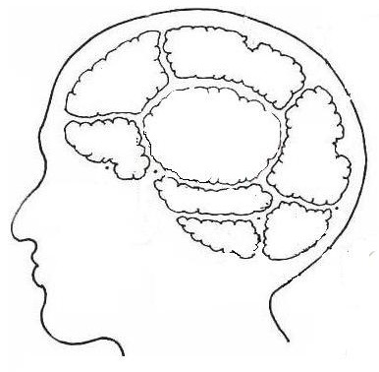

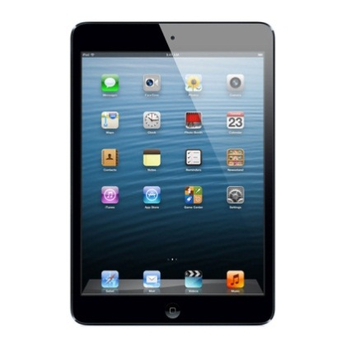
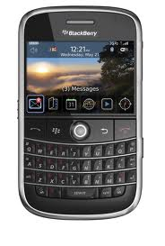
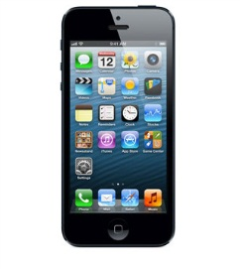
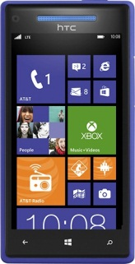
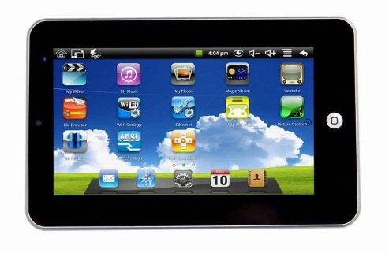
Cellular Provider’s Dilemma: Charging TCP Retransmissions
Subscriber’s point of view
Network condition
is not my concern
Volume = File size
Pay for
application layer
data only!
What’s
TCP
Retrans-mission?
ISP is evil
Equal pricing
Not fair
I don’t
care
Notes:
Let’s look at subscriber’s view on charging TCP retransmissions.
The main argument is that they should be charged for only the application layer data, which is the size of the content.
I don’t care what happens in the network. If this guy and I both watched the same movie content, we should be charged the same.

Slide 7

Cellular Provider’s Dilemma: Charging TCP Retransmissions
Cellular ISP’s point of view
Retransmission =
another IP packet
Require system update
TCP retransmissions
still consume
resources
Notes:
Then how about the cellular ISPs.
In their perspective, TCP retransmissions still consume their cellular network resources. To them, it’s just another IP packet.
Moreover, it would require a system that can accurately detect retransmission packets. They know that’s complex.
And… of course… not charging TCP retransmissions would mean losing money.
Then let’s see how much retransmission actually occurs in the real-world.

Slide 8


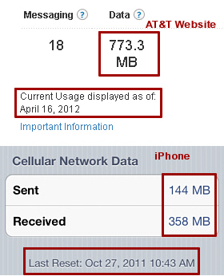
TCP Retransmission Accounting Policy
Retransmission test setup
Test Process
Client: download a file via wget
Server: retransmit packets via raw socket
Compare captured volume with charged volume provided by ISP
Cellular ISP
wget
raw
socket
Notes:
Now then next task is to check whether the ISPs account for retransmissions or not. We setup a following experiment.
We have a client device which downloads a file from our modified HTTP server through the cellular network.
The server would then create retransmission packets by using a raw socket and send them to the client.
For analysis, we capture the packets in the client and compare with charged volume provided by ISPs.

Slide 9
Controlled Retransmission
Server intentionally sends the same packet for ‘n’ times
(n = 10)
Data (Seq #: 1-1400)
ACK (Ack #: 1401)
Data (Seq #: 1-1400)
‘9’ Times
Dup. ACK (Ack #: 1401)
Data (Seq #: 1401-2801)
ACK (Ack #: 2802)
Notes:
For a simple test, we create controlled retransmissions where our server intentionally sends the same packet for ‘n’ times.

Slide 10
Controlled Retransmission
South Korean ISPs do not account for retransmission packets
U.S. ISPs account for all retransmission packets!
ISP Accounting
Normal Data / ACK Packet
Duplicate ACK
Retransmitted Data Packet
11,122.6
107.84
1,524.1
14.97
14.97
1,092.8
1,092.5
10.77
ISP-2, 3
Notes:
ISP-1 : 1MB 10 times
ISP-2, 3: 10MB 10 times
We see that South Korean ISPs do not account for TCP retransmissions.
Let’s look at them in more detail by separating packets by each type.
Left graph shows the accounting volume of ISP-1 in KBs while the right graph shows the volume of ISP-2, 3 in MBs.
The black bar shows the volume that the user actually has to pay.
We see that although both ISPs do not account for retransmission packets, their policy differs a little on what packets they do account for.
While ISP-1 does not account for duplicate ACKs, ISP-2, 3 does.
What’s more interesting is that U.S. ISPs account for all retransmission packets, which means that in case of ISP-2’s test, ISPs 3, 4 & 5 will charge you for 108MB instead of 15MB.
This raises a vulnerability in cellular accounting.

Slide 11
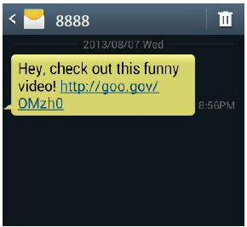
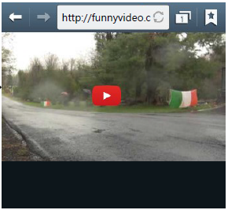
Usage-inflation Attack
Intentionally retransmit packets even without packet losses
ISPs with blind accounting policy charge for all packets
Attack scenario
Strength:
No need to compromise the client
User does not notice an attack
Inflate more than 1GB in just 9 minutes!
User clicks on the URL
Notes:
Let’s first focus on the usage-inflation attack.
The “usage-inflation” attack arbitrarily inflates the cellular data usage of a target subscriber by intentionally retransmitting packets in the flow even without actual packet losses. As a result, any ISP that follows the blind accounting policy will end up inflating the victim user’s bill.
Here’s one real-world attack scenario that we envision. A malicious attacker sends a phishing SMS message to a target client with the URL that leads to a malicious site.
When a user clicks on the link, he is redirected to that malicious Web server that inflates the usage by spurious packet retransmissions in the background. However, at the application layer, the server transfers the requested content to the client in a normal TCP connection.
The strength of this attack is that we do not need any modification of the client. As long as the user is redirected to the server, the attacker can inject any number of retransmission packets, which does not violate the TCP semantics.
Moreover, the user does not notice that any attack has taken place unless he checks the usage. Some of you may think that the attack must last long to actually inflate the user. Actually, we were able to inflate the user by over 1GB in just 9 minutes!

Slide 12

Retransmit after FIN
Ignore client’s FIN/RST to prevent TCP teardown
Utilize full bandwidth to overcharge the usage
Some ISPs allow attacks even after 4 hours!
$
Overcharge Victim UE
Packet 1
Wired Internet
$
Cellular Networks
Packet 2
$
Packet 3
Request
Packet 1
FIN
Packet 3
Packet 2
Packet 3
Packet 3
$
Packet 3
Malicious Server
$
Core Network
Victim Client
Packet 3
Notes:
We can carry out “usage-inflation” attack via two methods. First, we can start retransmitting after the client finishes downloading the content. That is, the server pretends that it did not receive the client’s FIN/RST and starts retransmitting the packets. Here is how it works…
This is advantageous in that the attacker can greatly overcharge the user by utilizing the full bandwidth.
We have confirmed that some ISPs keep the connection on, allowing us to carry out the attack even after 4 hours.

Slide 13
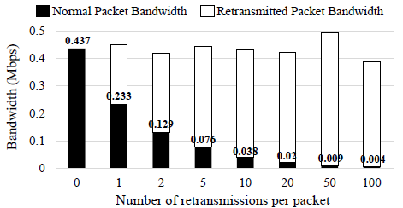
Retransmit during Normal Transfer
ISP may block data packet retransmissions after FIN/RST
Embed retransmission packets in stream of normal packets
Guarantee minimum bandwidth for interactive content
Question:
What happens if we can tunnel the packet
inside retransmission packets?
Notes:
Although strong, this has a weakness that the ISP can easily detect the attack by preventing high retransmissions after FIN/RST.
A more sophisticated attack is to embed the retransmission packets in the middle of the data transfer. Instead of blindly retransmitting the same packet over and over again, the attacker can carefully pick a random packet in its send window.
To prevent the user from noticing a slowdown, the attacker can control the goodput in case of interactive contents.
(Audio stream typically requires 500 Kbps while video streaming requires 2 Mbps)
Here’s a graph that shows the effect of inserting retransmission to the stream of normal packets. We see that as the number of retransmissions per packet increases, the bandwidth decreases linearly. So if we pick the right number of retransmissions, we’ll be able to inflate the user without alerting the user with a slowdown.
So we showed at attack for U.S. ISPs. Then what about South Korean ISPs? They are not vulnerable to usage-inflation attack.

Slide 14
Tunneling through Retransmission
Server sends the same header for ‘n’ times with different payload
(n = 2)
ISP Accounting
Normal Data Packet
Normal ACK
Duplicate ACK
TCP Tunneled Packet
107.51
10,992.8
55.81
55.81
53.65
5,469.4
5,704.4
51.49
5,483.4
5,272.3
Notes:
In order to check for this, we create TCP-tunneled retransmission packets where the payload of retransmitted packets are different.
…(Explain the result)
We find that ISPs do not account for TCP-tunneled retransmission packets!
This is pretty intuitive since analyzing the payload of all packets would require lots of CPU cycles, a huge performance overhead.

Slide 15
Free-riding Attack
Tunnel payload in a packet masquerading as a retransmission
ISPs with selective accounting policy inspects TCP header only
Tunnel TCP Packet
Wired Internet
Cellular Networks
$
Fake TCP Hdr
Packet 1
Packet 2
Packet 1
Fake TCP Hdr
Packet 2
Packet 1
Packet 1
Packet 3
Packet 2
Fake TCP Hdr
Packet 3
Request
Fake TCP Hdr
Packet 2
Fake TCP Hdr
Packet 3
Packet 3
Fake TCP Hdr
Destination
Server
TCP Tunneling
Proxy
Core Network
Malicious UE
Notes:
Next, if the cellular ISPs decide to exclude retransmission packets from billing, an adversary can launch a “free-riding” attack against them by tunneling the actual payload in a retransmission packet. This is possible since the ISP only inspects the TCP header. This is pretty intuitive since to validate the retransmission, the ISP would have to buffer all payloads for future comparison, which is not easy.
This is how the attack works.

Slide 16
Free-riding Attack Architecture
User Equipment
Cellular
ISP
TCP Tunneling Proxy
Application
NAT
Pkt A
Pkt B
Pkt C
Pkt A
Pkt B
Pkt C
Result:
Successfully use the cellular network for
‘n’ times more than the accounted volume!
tun0
tun0
Pkt A
Pkt B
Pkt C
Pkt A
Pkt B
Pkt C
Vtund Client
Vtund Server
Fake Hdr
Pkt A
Fake Hdr
Pkt A
Fake Hdr
Pkt B
Fake Hdr
Pkt B
Fake Hdr
Pkt C
Fake Hdr
Pkt C
Notes:
This is the overall architecture of the attack implementation.
On the client side, we run a modified VTun daemon that captures all the packets from applications and insert new TCP/IP headers destined to the tunneling proxy.
The tunneling proxy is responsible for detunneling the packets from the client and relaying the original packets to the real destination. After decrypting the payload and extracting the original packet, the proxy forwards it to a NAT table. NAT is responsible for translating the client-side IP address and the port number to those of the proxy and vice versa. The downstream case works in the same way.

Slide 17

Free-riding Attack Demo

Slide 18
Conclusion
Massive growth in cellular data usage
Importance of accurate accounting of cellular traffic
Cellular ISP dilemma
Should we account for TCP retransmissions packets or not?
Accounting policies differ between countries
Vulnerabilities in current accounting system
Usage-inflation attack
Free-riding retransmission attack
Defense for free-riding attack via DPI monitoring system
Notes:
We have seen a massive growth in the cellular data usage.
However, the cellular ISPs are in a dilemma on whether to account for TCP retransmissions or not.
Through experiments, we see that no ISPs have perfect accounting policy for TCP retransmissions.
Some ISPs account for duplicate ACKs, some ISPs do not account for TCP headers of all partially-retransmitted payload packets.
Moreover, we have shown that whether we account for TCP retransmissions or not, ISPs are vulnerable to either usage-inflation attack or free-riding retransmission attack.
For future work, we suggest a probabilistic DPI system, which can accurately detect fake TCP retransmissions in high-speed.

Slide 19
Thank You! Any Questions?
yhwan@ndsl.kaist.edu

